Slide 1
Note to Educators
This is the deck for the Azure Fundamentals (AZ-900) Virtual Educator Prep Session
It is not intended to be Student facing
Please do not share

Slide 2
Microsoft Learn for Educators Virtual Educator Prep Session
Azure Fundamentals (AZ-900)

Slide 3


Welcome! Let’s get acquainted
Experience
[2-3 Bullets]
Highlights
[2-3 bullets}
Location
[your location]
Contact
[Your LinkedIn or whatever contact info you prefer to share]
[Your Name]
Microsoft Technical Trainer

Slide 4

Welcome!
Experience
Software Developer
Technical Consulting
Microsoft Technical Trainer
Highlights
Azure Fundamentals
Azure AI Fundamentals
Microsoft Certified Trainer
Location
Dallas, TX United States
Contact
aka.ms/MahlahMurray
Mahlah Murray
Microsoft Technical Trainer

Slide 5
Virtual Educator Prep Session expectations

Slide 6









Introductions!
What excites you about Azure Fundamentals?
Please tell us about your cloud experience.
What are your expectations for this prep session?

Slide 7

Virtual Educator Prep Session agenda
Resources
Accessibility
Overall approach
Technical requirements
Course flow
Module best practices
Demos
Lab strategies
Supplemental materials
Exam preparation

Slide 8
Resources

Slide 9

Get ready!
Start learning
Practice exam
Certification exam
Complete Azure Fundamentals self-paced learning on Microsoft Learn
Attend a Microsoft Virtual Training Day: events.Microsoft.com
Free or discounted practice exams are available to Educators
Exam vouchers are available to Educators

Slide 10

Overview of teaching materials on Learning Download Center
Assessment Guide | Course Datasheet | Educator Teaching Guide | Lab Instructions | PowerPoint Files | Trainer Handbook
Guidance on assessments | Course description, learning objectives, course outline, and course timings | High level overview of course materials and planning tools, technology requirements | Walkthroughs for you to demo with students | PPT slides you can use for delivery of content in class | Provides foundational level knowledge on cloud concepts
aka.ms/LDC

Slide 11





Azure credits
Access to Azure credits and free developer tools
Based on feedback from students and instructors
Azure Fundamentals uses $10 or less.
To complete all the Fundamentals courses, Azure fees total approximately $55, if you shut down all Azure services when not in use.
Useful links
azure.microsoft.com/en-us/free/students/
azure.microsoft.com/en-us/free/
aka.ms/azlabs
aka.ms/ADT4T
Students: Get $100 credit when you create your free Azure for Students account. 12 months of free Azure services, renewable annually (for students over 18)
Educators: Get $200 credit (check by geo) of free Azure services when you create your free Azure account
Azure Lab Services enables educators to set up and provide on-demand access to preconfigured virtual machines (VMs) to support classroom scenarios
Azure Dev Tools for Teaching is available to institutions with Microsoft volume license agreements. For more information, connect with your Microsoft contact
Notes:
FAQs
What if I run out of credits? Reach out to your Microsoft contact to understand options available to your institution.
What if my students run out of credits? Reach out to your Microsoft contact to understand options available to your institution.
When completing AZ-900 on the self-paced training on Learn, you’ll need:
- 50% Labs in sandbox = no Azure credits needed
- Other 50% require Azure Credits

Slide 12
Accessibility

Slide 13
Accessibility
Make your PowerPoint presentations accessible
Create accessible content
Accommodate student’s diverse needs
Hearing
Mobility
Vision
Neurodiversity
Creating a digitally diverse learning community
Bias free communication
Inclusive Design Methodology

Slide 14
Overall approach

Slide 15






Objective domains
Module 1
Module 2
Module 3
Cloud concepts
Core Azure services
Core solutions and management tools
Module 4
Module 5
Module 6
General security and network security
Identity, governance, privacy, and compliance
Azure cost management and Service Level Agreements

Slide 16



Certification areas (AZ-900)
Study areas | Weight
Describe Cloud concepts | 20-25%
Describe core Azure services | 15-20%
Describe core solutions and management tools | 10-15%
Describe general security and network security | 10-15%
Describe identity, governance, privacy, and compliance | 20-25%
Describe Azure cost management and Service Level Agreements | 10-15%
This course maps directly to the exam AZ-900 Microsoft Azure Fundamentals
Percentages indicate the relative weight of each area on the exam
The higher the percentage, the more questions you are likely to see in that area

Slide 17





Overall approach – setting expectations
Who is the audience?
What are the prerequisites?
Hands-on Labs
Goal: Azure Certification

Slide 18
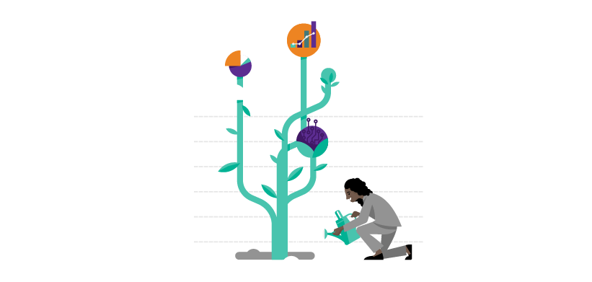
Customize content to fit your environment
Azure Fundamentals provides approximately 16 hours of content that can be used in many environments, including:
Inside an existing course
Alongside a course where learning objectives are broadly aligned
As a standalone course
Time required will vary based on approach and labs

Slide 19
Technical requirements

Slide 20

Technical requirements for Educators and Students
Educator hardware and software requirements:
PC or laptop
Access to the internet
Modern operating system
Modern browser
Microsoft PowerPoint
Ability to display PowerPoint slides to students
Azure subscription
Student hardware and software requirements
PC or laptop
Access to the internet
Modern operating system
Modern browser
Azure subscription recommended for lab practice
Classroom hardware and software requirements:
Access to the internet
An open Port 80 and Port 443 so you and your students can access Azure via a modern web browser

Slide 21
Course flow

Slide 22

Going with the flow
Order deck for optimal flow
Deliver all modules in multiple sessions
Align time spent with relative weights
Conduct review questions after each module
Develop slide deck notes
Whiteboarding where appropriate

Slide 23
Module best practices

Slide 24

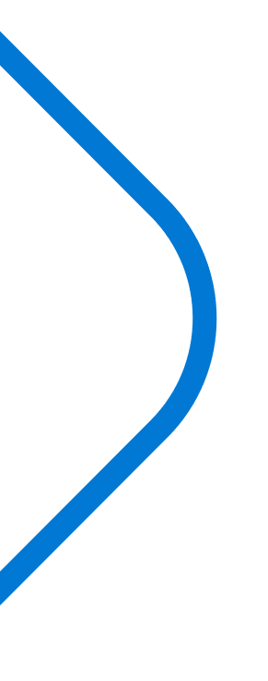
Tips for Module 1 – Core Azure concepts
Building the foundation of the cloud
Key terms, Cloud services, Cloud Models
Architectural Components
Subscriptions, Resources groups, Regions, Availability Zones
Use storytelling and case studies
Focus on real institution examples

Slide 25

Tips for Module 2 – Core Azure services
Break up into multiple sessions
Use storytelling and case studies
Explore databases
Explore compute services
Explore storage services
Explore networking services
Choose most appropriate demos

Slide 26

Tips for Module 3 – Core solutions and management tools
Artificial Intelligence services
Tools for organization
Devops, Github, DevTest Labs
Monitoring services
Advisor, Monitor, Service Health
Azure Management tools
Scripting languages
Serverless Computing
IoT services
Choose most appropriate demos

Slide 27

Tips for Module 4 – General security and network security features
Incorporate whiteboarding or diagrams (Firewall versus Network Security Group)
Use examples around security solutions
Demo Azure Security Center
Demo Azure Key Vault

Slide 28

Tips for Module 5 – Identity, governance, privacy and compliance features
Identity services
Authentication versus Authorization
Azure Active Directory
Cloud governance strategy
Cloud adoption journey
Subscription governance, RBAC, Resource locks, Tags Azure Policy
Use Service Trust Portal, Trust Center websites instead of slides

Slide 29


Tips for Module 6 – Azure cost management and Service Level Agreements
Demo Azure Pricing Calculator
Demo Total Cost of Ownership (TCO) calculator
Explain Service Level Agreements
Explain preview services and preview features

Slide 30
Demos & labs

Slide 31


Show me!
General portal demo should be first
Have students do a demonstration
Don’t do all of them, do a variety of demos, do the ones that are not similar
Use pre-baked environment for certain demos (Azure Monitor, Security Center)
Record demos
Use region closest to your location
Familiarize yourself with labs and be able to troubleshoot

Slide 32
Supplemental materials

Slide 33






Supplemental materials
Online documentation
MS Learn
Azure Blog
Microsoft hands-on labs
Reference Architectures
Videos
Skills measured
aka.ms/AZ-900Update
Microsoft Docs
aka.ms/Docs
Microsoft Learn
Microsoft.com/Learn
Certification poster
aka.ms/TrainCertPoster
Notes:
Azure Blog: https://azure.microsoft.com/en-us/blog/
Channel 9: https://channel9.msdn.com/
Microsoft Docs: https://docs.microsoft.com/en-us/azure/
Azure Architecture Centre: https://docs.microsoft.com/en-us/azure/architecture/
Github Repo: https://github.com/MicrosoftDocs/
Exam: https://docs.microsoft.com/en-us/learn/certifications/exams/az-900
Microsoft Learn for Educators: https://docs.microsoft.com/en-us/learn/support/educator-resources
Azure Community Support: https://azure.microsoft.com/en-us/support/community/

Slide 34
Exam preparation

Slide 35


Wrap up
Summary of learning
Learning resources
Exam discussion

Slide 36

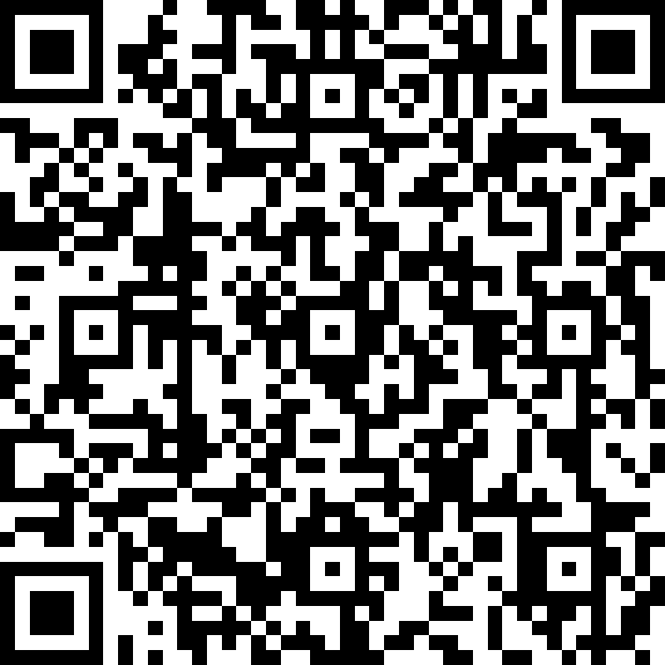
Take the survey
Please help us continue to improve our trainings by completing our survey at aka.ms/MSLEVEPSSurvey

Slide 37
Thank you!

